Slide 1
TEAM PARRILLA

Slide 2

Problem
60% fail within first 3 years
80% have no strategic plan for social media
Stressed, no time, don’t know what to do =
Notes:
walked down street….?
60% fail - ABS stat
how can that be? there’s so many marketing channels now to connect with customers..
80% no strategic plan for social media - Sensis social media report 2015
-- no clear idea how to use it effectively
business owners…
how do you help these people who have no time and sometimes dont know what to do improve their business?

Slide 3
Value Proposition
Connect business with highly relevant customers
Segmented based on real data not interpolated data
Notes:
what if you make it easier for them to reach customers? and not just any customers, i mean relevant customers….highly segmented customers who are screened based on age, gender, location, income and purchase history. not just guesses based on browsing history or social media participation.
why can we do this? NAB has a large retail customer base?
how r we going to do this?

Slide 4
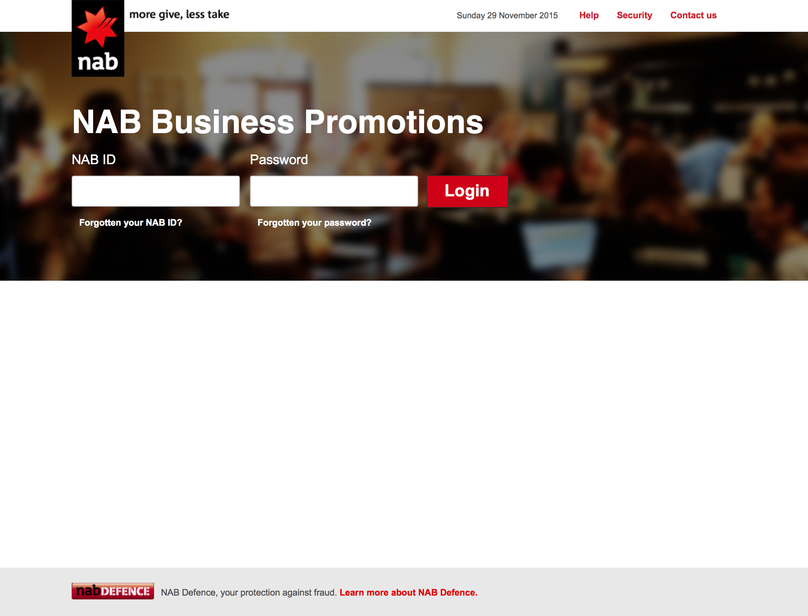
Notes:
NAB Business Promotions
A platform for small business customers to engage and market to highly relevant customers within NAB’s retail customer database

Slide 5
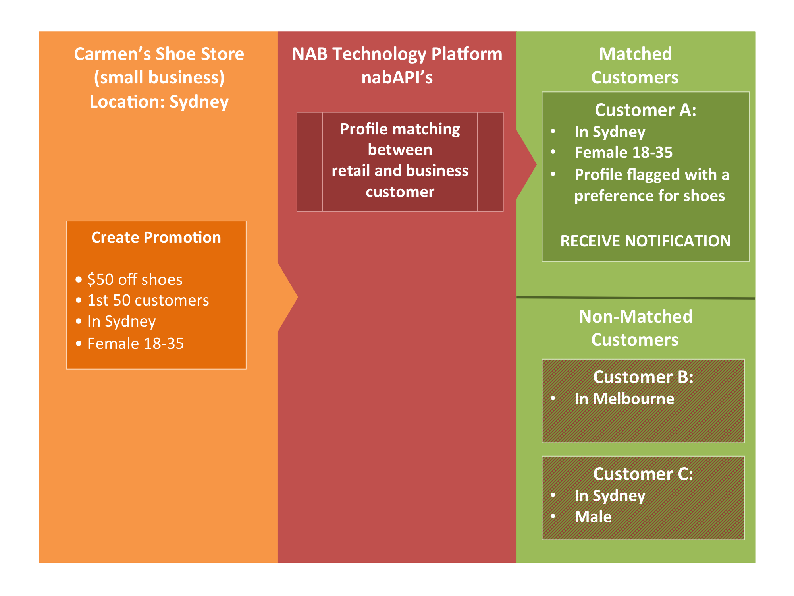
How does it work?
Notes:
let’s consider the case of carmen.
carmen shoe store
create promotion and send to NAB’s platform

Slide 6
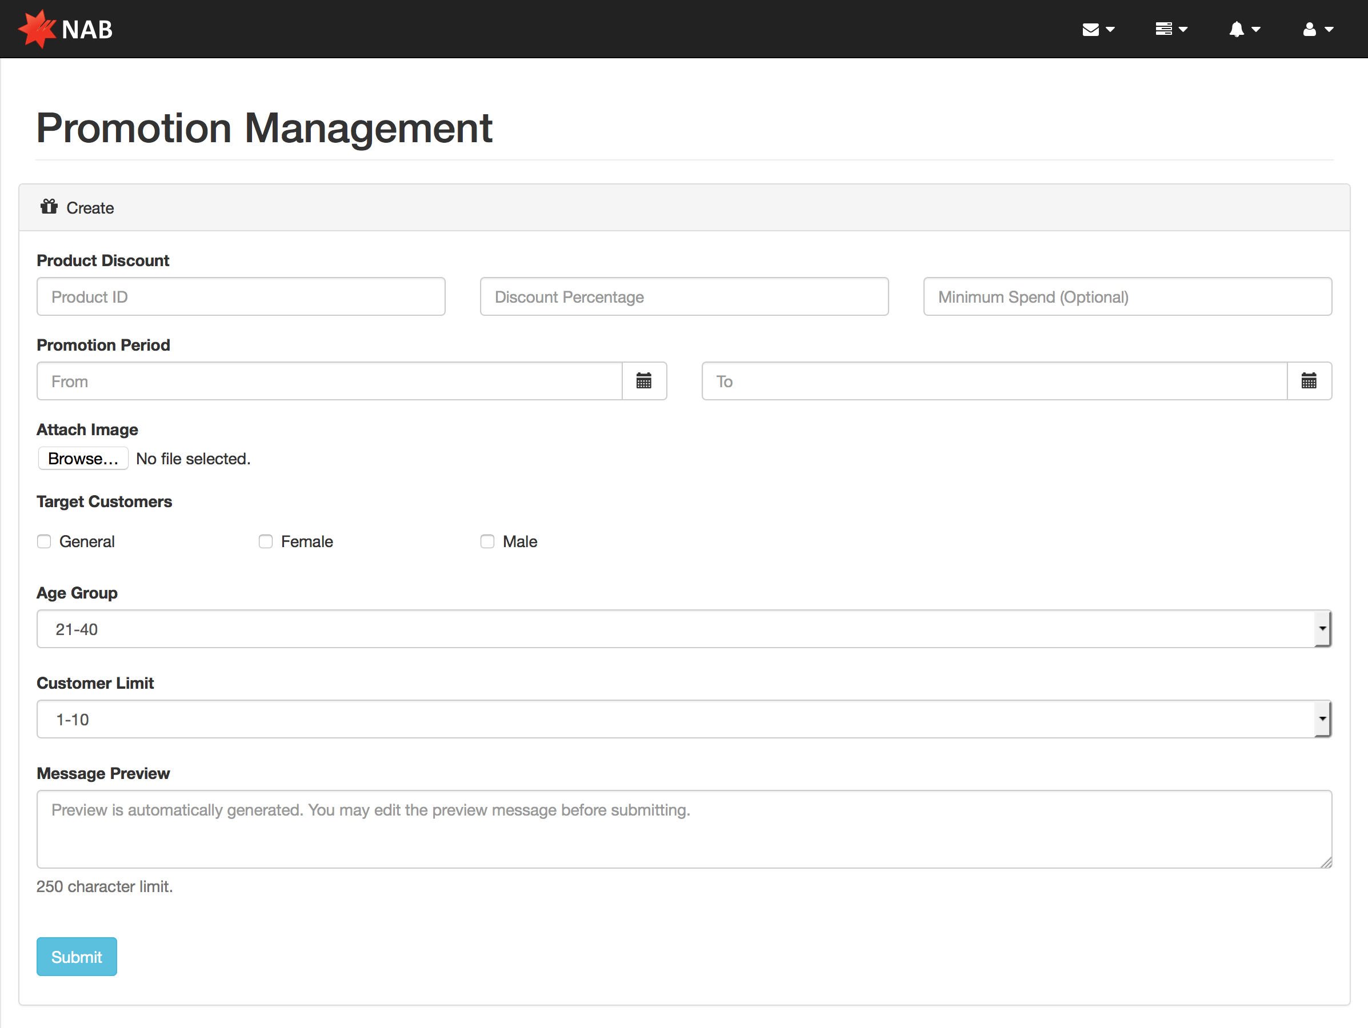
Notes:
very simple - so user focuses on one thing and not distracted
creates promotion, choose various details - duration, specific restrictions - then she sends it off NAB’s secured servers

Slide 7
How does it work?
Notes:
when NAB receives the promotion, carmen’s business profile and the details of the promotion are matched against segmented individuals within NAB’s retail customer database
since the matching and processing is all done within nab’s servers, no data is exchanged and our customer’s PRIVACY and data is safe guarded and secure
identifies someone - let’s call her anne.

Slide 8
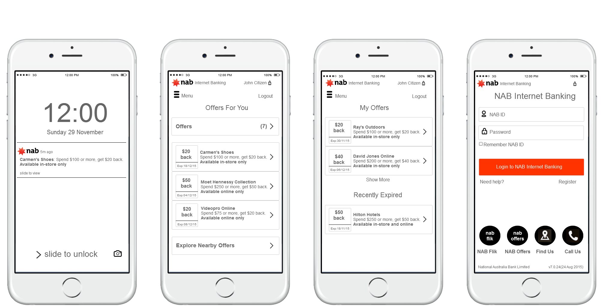
Notes:
pushed to NAB mobile app - no need to get users to download a new app, as millions of NAB retail customers already have the app installed on their mobile devices
if a customer chooses not to save the offer then we can record that in our database and improve our profile of that customer for the future
for retail customers, participation in this offer program is entirely optional - so users can choose to turn off notifications or opt out of receiving offers in the app settings
however, there are similar offer programs currently in the market (for example, amex) and we have learned that the offers program is quite well regarded as the customers do value the savings these offers can provide
what about people who dont have the nab app? well..for those users, we have the nab customer internet banking platform

Slide 9
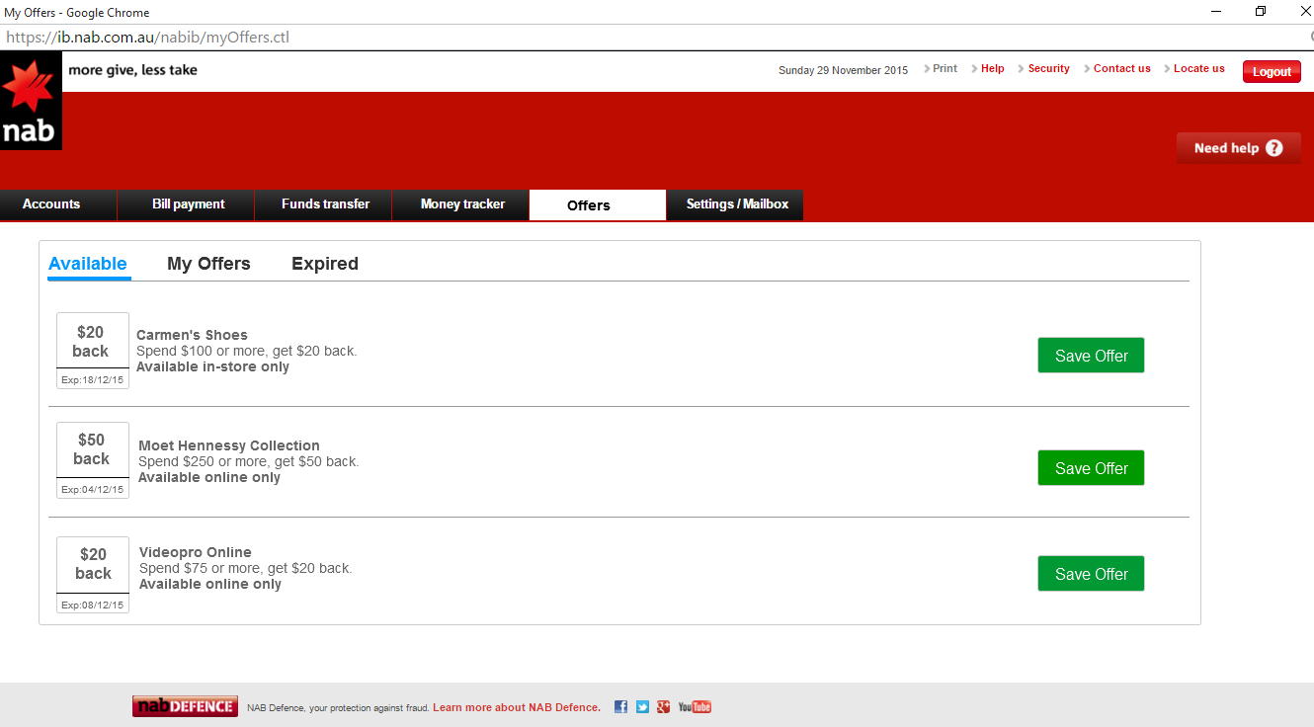

Slide 10
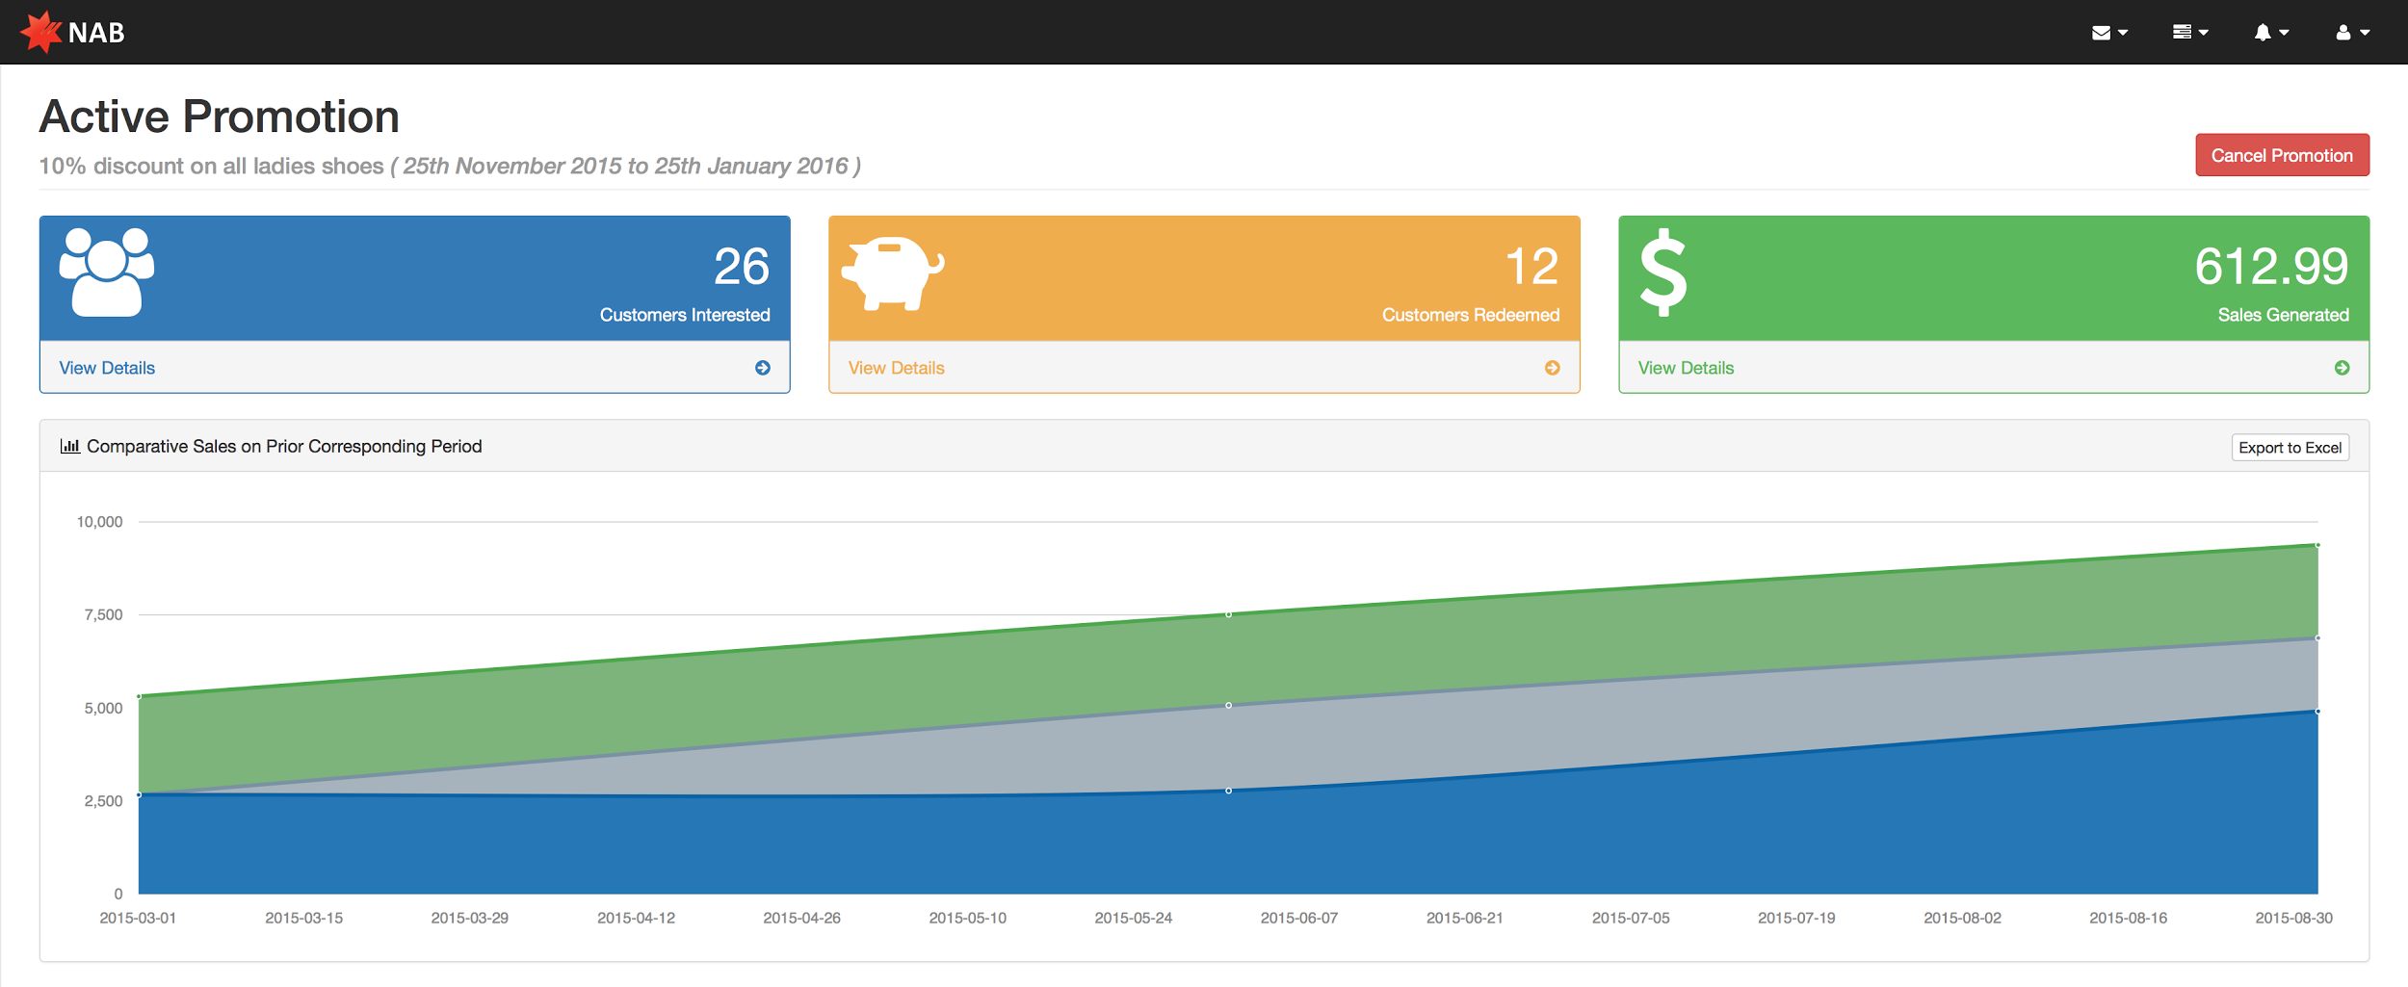
Notes:
now this is all about helping the business customer, so what happens on the business’ side of things?
well, if carmen logs checks the promotions webpage, because there is an active promotion she gets to see some metrics...such as how many people are interested, how many people have redeemed the offer, and sales generated from this promotion
it’s all simple and non-technical to make sure we do not confuse and complicate things for the business customer
SIMPLE, RELEVANT INFORMATION

Slide 11
Pricing
1/month free for small businesses
Tiered structure based on turnover/number of promotions

Slide 12
Why are we doing this?
Unlocking intrinsic value
Marketing potential for generating new business
Reward retail customers
Notes:
helping business partners - increase loyalty, improve customer retention, more profitable over longer term - sell other services
unlocking intrinsic value of retail customer database - large dataset which is already there, and is of great value to businesses, but not being used
this can be applied to both small and large businesses whether based locally or globally
compelling business case with huge marketing potential - spoke with bar manager currently using social media for promotions - said if we could provide access to better targeted audience that creates a significant consideration to switch banking providers
reward customers - bonus

Slide 13

Notes:
Summary - our goal is to help small businesses connect with the right customer in the simplest way possible; and if we get it right, we hope we can turn this...
into this….

Slide 14
THANK YOU

